Slide 1

Big Resort Mountain Slide Deck
Sadekin Hasnath
3/7/25

Slide 2
Problem Identification – Business Challenge
Big Mountain Resort recently invested $1.54 million in a new chairlift for increased capacity.
They were already charging premium prices, but the revenue wasn’t reaching its potential.
There were no structured pricing strategies, such as data-driven pricing.
The question was how could we maximize ticket pricing strategy for Big Mountain Resort by leveraging data-driven analysis to estimate competitive market prices for revenue optimization.

Slide 3
Recommendation and key findings
From the full complete analysis of our project, we anticipated numerous findings, but this is the most critical insight.
The current ticket price for big mountain resort was at $81.
The predicted optimal price was $95.87, an optimal range of $85.48-106.26.
This indicated that the resort were undercharging, leaving out on potential revenue.
Best approach would be to modify the ticket price close to $95.87.
Top 3 pricing influencers
Vertical drop
Fast Quad Lifts
Total Chairs
Runs
Close the least used runs, but not more than 5+ as this reduces revenue noticeably.
Increase vertical drop and add a chairlift for the best financial outcome.

Slide 4
Data Wrangling & Feature Selection
Our key goal was to wrangle the data into a consistent and proper format by removing redundant and outliers, as this is a crucial step for maintaining the values that would provide the best insights.
Initial dataset - 330 resorts, 27 features
Final dataset - 227 resorts - 25 features
Target Variable - AdultWeekend ticket price

Slide 5
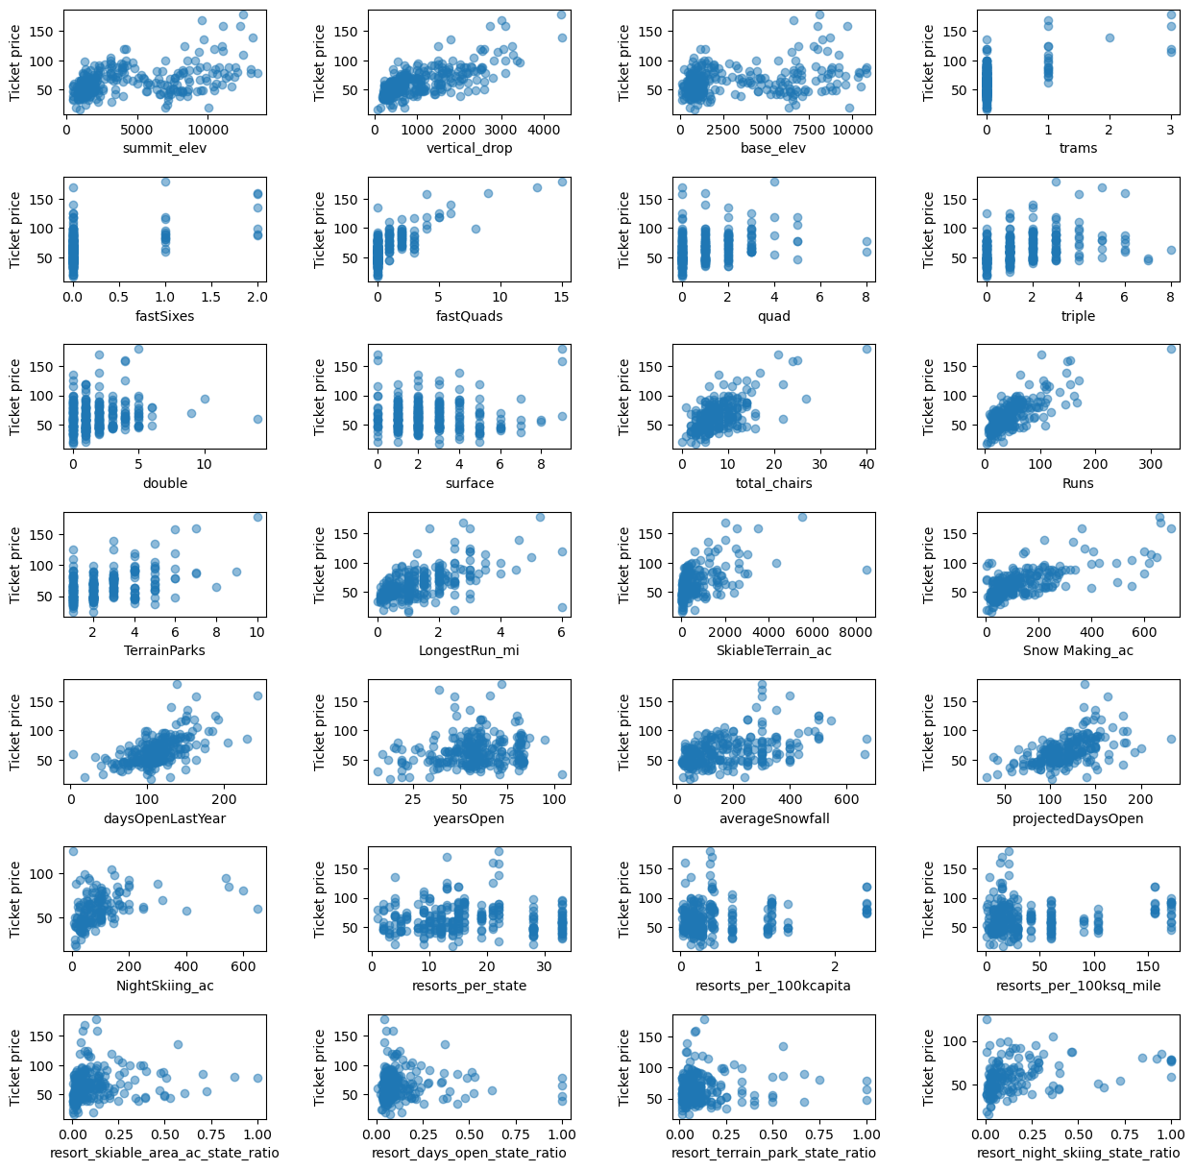
Exploratory data analysis
Insights from EDA exploratory data analysis, these were the most important key takeaways.
A strong positive correlation was observed between vertical drop, fast quad lifts, number of runs, total chairs, and ticket price.
Negative Correlation between skiable terrain area, likely due to crowding.
Visitors also value snow coverage, as this indicates guaranteed snow for skiing.

Slide 6
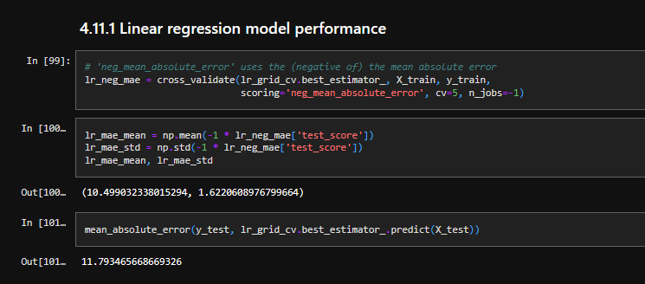
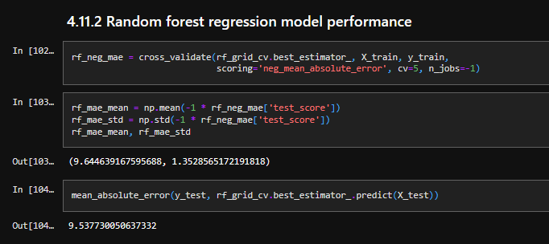
Model Performance & Selection
After training the data in 70/30 split, we had to impute for missing values, transform by scaling, and then finally we tested 2 different models, and went with the best.
Linear Regression
Performed poor due to non-linear relationships in the data.
Random Forest Regressor
This model provided more accurate predictions by capturing complex interactions between variables. This model was selected since it was close to the actual ticket price by $1.

Slide 7
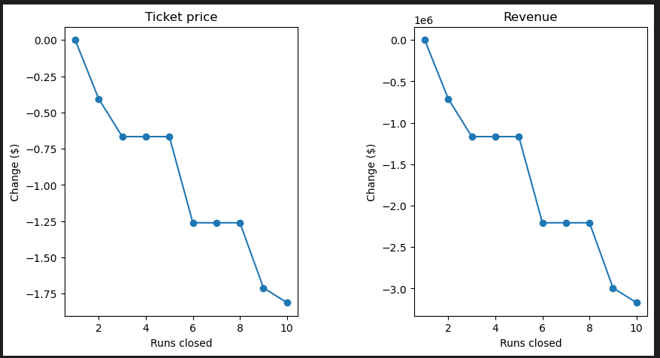
Modeling Scenarios
Adding a vertical drop of 150 ft along with a chairlift
Revenue increase: $3,474,638
Ticket price increase: +$1.99
This is the best possible scenario Big Mountain Resort can implement for revenue growth.
Closing least used runs
Closing 1 run - No impact
Closing 3-5 runs - Revenue decline by $700K-2.3M.
Closing 5+ runs - Significant loss.
Additonal 2 Scenarios
Adding a snow making machine along with the previous scenario.
This scenario had same revenue as the vertical drop one, except the additonal equipment, uncessary investment.
Increasing the Longest Run by 0.2 Miles
No impact on revenue, should not be a a priority investment.

Slide 8
Summary & Conclusion
Big Mountain Resort is undercharging - Raising prices would be a viable option, within the prediction range of $95.87 (range: $85.48 - $106.26).
Investing in vertical drop expansion & chairlifts offers the best return.
Closing underused runs can cut costs, but too many closures harm revenue.
Future Recommendation:
Implement a tiered pricing model.
A dynamic dashboard could be developed, to hypothetically allow analysts to test pricing scenarios in real-time and make data-driven decisions.

